Slide 1
CS 540 Network Architecture
Lecture 1: Data Center Networking
Prof. Younghee Lee
Some part of this teaching materials are prepared referencing;
Kai Chen et al., Survey on Routing in Data Centers: Insights and Future Directions, IEEE Network 2011
Albert Greenberg, VL2: A scalable and flexible data center network SIGCOMM 2009
Albert Greenberg, Networking the cloud ICDCS 2009 Keynote talk
Albert Greenberg, The cost of cloud: research problems in data center networking, ACM CCR Review, 2009

Slide 2
The cost of a Cloud
- *3 yr amortization for servers, 15 yr for infrastructure; 5% cost of money
- Someone claims that 30% utilization considered “good” in data centers
Causes of low utilization
Uneven application fit:
Long provisioning timescales:
Uncertainty in demand:
Risk management: Hoarding
Virtualization short fall

Slide 3
The Cost of a Cloud
Networking and systems innovation is the key to reducing cost
agility: the ability to dynamically grow and shrink resources to meet demand and to draw those resources from the most optimal location
Today’s network stands as a barrier to agility and increases the fragmentation of resources that leads to low server utilization.
“A good user experience depends on predictable performance within the data-center network.”
Dennis Abts, Bob Felderman, Google

Slide 4
Types of Cloud Service Data Centers
Massive data analysis applications (e.g., computing the web search index)
fit for a mega data center, where some problems require huge amounts of fast RAM
extensive communication between servers: Propagation delay
cost of communication would go up if the servers were spread out across multiple data centers separated by long distance links
Multimedia services
require massive disk I/O bandwidth.

Slide 5
Networking in Current Data Centers
Two types of traffic:
traffic flowing between internal servers.
Internal computation (e.g., MapReduce for web indexing)
In search applications internal traffic dominates – building and synchronizing instances of the index.
traffic flowing between external end systems and internal servers
e.g., Serving web pages to users
In Video download applications, external traffic dominates.

Slide 6
Types of Cloud Service Data Centers
Location
Huge numbers of servers in the same location
eases systems design
lowers the cost of supporting applications with multiple dependencies
micro data centers,
having on the order of thousands of servers
Highly interactive applications (e.g., query/response applications, or office productivity applications) are a natural fit for geo-diverse
For content distribution networks and other “distributed” applications, such as email
would support wider classes of applications.

Slide 7
DCN topology
Layer 3 approach
Assign IP addresses to hosts hierarchically based on their connected switch.
Routing protocol such as OSPF
Large administration overhead
Good for “scalability”
Layer 2 approach
Flat MAC addresses
Bad scalability: limited in size to about 4,000 servers in practice due to “Flooding”
Less administrative overhead
Good for “Plug and play” & “Seamless VM migration(no change to IP end point)”
End host virtualization
To support VM migration(e.g., vMotion)
Layer 3 case: Migrating the VM to a different switch => VM’s IP address change
Layer 2 case: it incurs scaling ARP with forwarding on huge flat MAC addresses

Slide 8
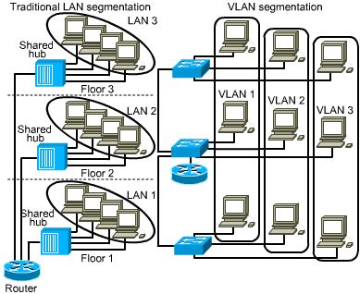
DCN topology
Between layer 2 and layer 3
Layer 2 domain is divided up into subnets using VLANs:
one subnet per VLAN
For smaller scale topologies
Resource partition problem
VLANs are often policy-overloaded, integrating traffic management, security, and performance isolation
VLAN spanning, and use of large server pools in general, concentrates traffic on links high in the tree, where links and routers are highly overbooked.

Slide 9
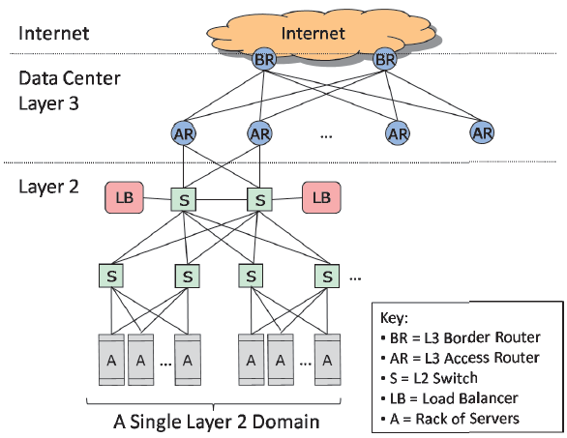
Networking in Current Data Centers
Virtual IP address (VIP):
the IP address to which requests are sent: assigned to multiple applications rather than server/NIC
Direct IP address (DIP): host id.
IP addresses of the servers over which the requests are spread
If one load balancer fails, the other picks up the traffic
For each VIP, the load balancers are configured with a list of DIPs
Equipment higher in the hierarchy handles more traffic, more expensive, more efforts made at availability
scale-up design
Servers connect via 1 Gbps UTP to Top of Rack (ToR) switches
Other links are mix of 1G, 10G; fiber, copper

Slide 10
Fragmentation
Destination NAT (or half-NAT)
transparently changing the destination IP address of an en-route packet and performing the inverse function for any replies. Source IP address is preserved.
require that all DIPs in a VIP’s pool be in the same layer 2 domain (why?)
Load balancing via Source NAT (or full-NAT)
rewriting the source and/or destination addresses of IP packets: secure
allow servers to be spread across layer 2 domains, (why?)
but then the servers never see the client IP
which is often unacceptable because servers use the client IP for example data mining etc.,
Client IP
LB IP
NAT Table
Step | Process | Source IP | Destination IP
Step 1 | Client to load balancer | 1.1.1.1 | 2.2.2.2
Step 2 | Load balancer to server | 1.1.1.1 | 3.3.3.3
Step 3 | Server to load balancer | 3.3.3.3 | 1.1.1.1
Step 4 | Load balancer to client | 2.2.2.2 | 1.1.1.1
Full-NAT NAT Table
Step | Process | Source IP | Destination IP
Step 1 | Client to load balancer | 1.1.1.1 | 2.2.2.2
Step 2 | Load balancer to server | 3.3.3.1 | 3.3.3.3
Step 3 | Server to load balancer | 3.3.3.3 | 3.3.3.1
Step 4 | Load balancer to client | 2.2.2.2 | 1.1.1.1
VIP
VIP
DIP
DIP

Slide 11
Routing in Data Centers
DCN: contain tens or hundreds of thousands of servers.
Communication intensive
a simple web search request may touch 1000+ servers, and data storage
Analysis applications may interactively process petabytes of data on thousands of machines.
Various traffic patterns
one-to-one, one-to-all, and all-to-all communications.

Slide 12
Basic Data Center Routing
Motivations and Challenges
The main challenge is how to build a scalable DCN that delivers significant aggregate bandwidth
Research efforts: BCube, DCell, PortLand, VL2, Helois, and c-Through
Existing Solutions
Routing in Server-centric Structures
servers act not only as end hosts but also as relay nodes for multihop communication
Bcube, DCell
Routing in Switch-Centric Structures
switches are the only relay nodes
PortLand, VL2
use a special instance of a Clos topology called Fat tree to interconnect commodity Ethernet switches.
Hybrid Electrical/Optical Structures
using high-capacity optical fibers and optical switches
c- Through, Helios

Slide 13
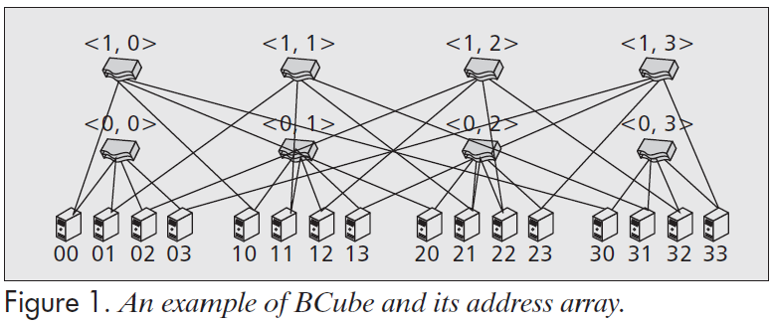
Server centric structure
Bcube: Servers are configured with multiple ports, and switches connect a constant number of servers.
A BCube0 is simply n servers connecting to an n-port switch.
A BCube1 is constructed from n BCube0s and n n-port switches.
Bcube_{k} recursively constructed from Bcube_{k-1}
two neighboring servers that connect to the same level i switch are different at the ith digit.
BCube build its routing path by “correcting” one digit at one hop from the source to destination. Figure 1 is an example of a BCube1 (n = 4) network.
The routing paths from 00 to 23 can be 00-20-23 or 00-03-23. (20, 03 => relay node)
Level 1
Level 0
BCube0

Slide 14
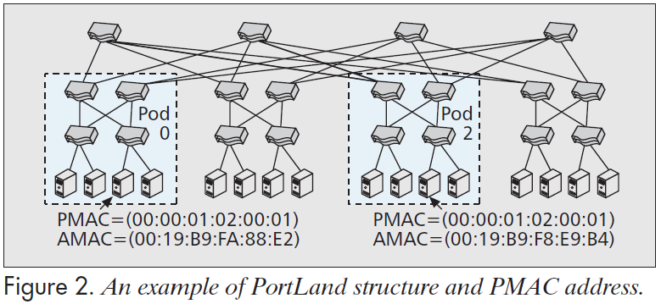
Switch centric structure
PortLand: A scalable layer 2 DCN that scales to millions of endpoints
3 layer Fat Tree: core, aggregate, and edge switches
Each end host has actual MAC address (AMAC) and pseudo MAC address (PMAC)
Proxy based ARP: Fabric manager
Use IP address as host identifier:
needs IP to PMAC mapping and name resolution: distributed location discovery
Encodes topology information of a host into its PMAC with the form of pod:position:port:vmid : positional pseudo MAC address
Pod (16 bits) reflects the pod number of an edge switch
Position (8 bits) is its position in the pod
port (8 bits) is the switch local view of the port number the host is connected to
Vmid (16 bits) is for virtual machines on the same physical machine
PMAC
- assigned by switch
0
1
2
3
2
3
(00:02:01:02:00:01)

Slide 15
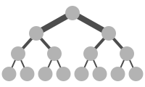
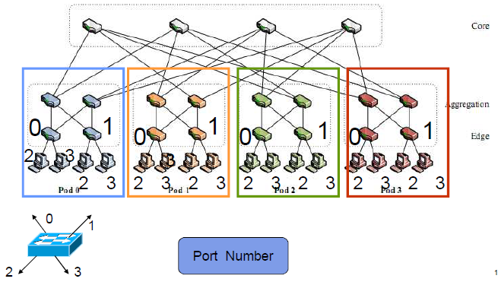
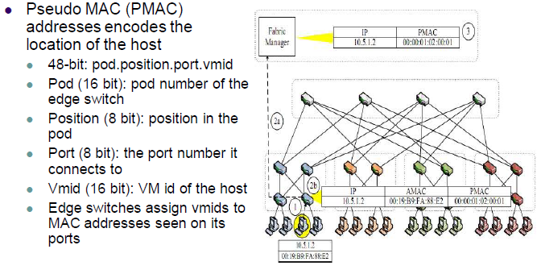
PortLand
Fat Tree topology
Split fat tree into k pods (k=4)
B/W or capacity progressively increases higher towards the root: "fatter" as one moves up the tree towards the root
Positional addressing
Network change solution => No change to host, L2 solution
Position Number

Slide 16
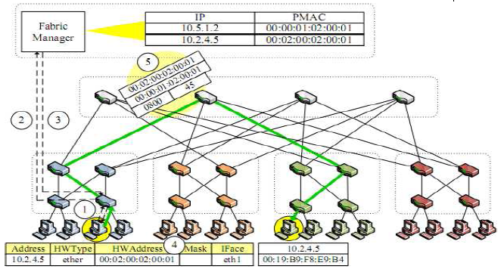
PortLand
Fabric Manager
Centralized to eliminate the need for administrator configuration
Maintains soft state about network configuration information
Responsible for assisting with ARP resolution, fault tolerance and multicast

Slide 17
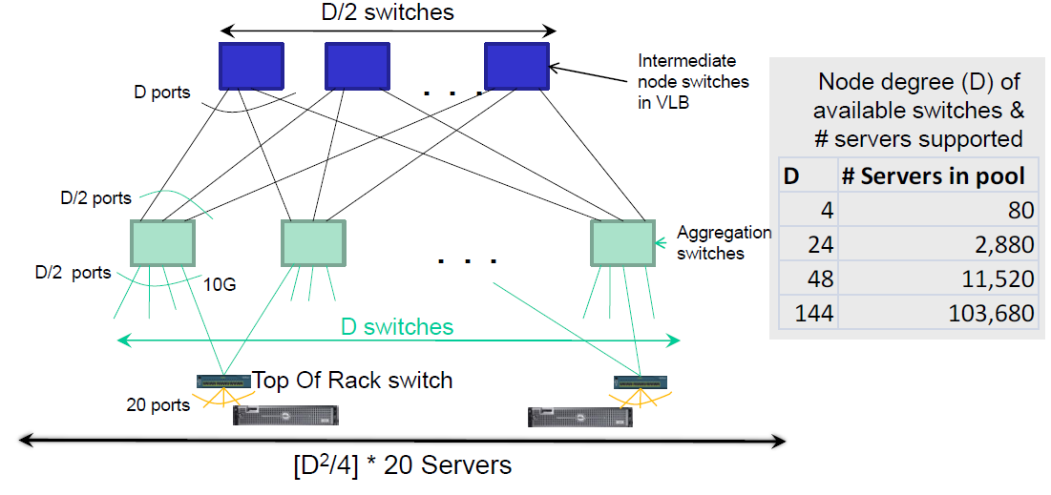
VL2
Basic Idea
Configure servers in such a way that they appear to be in one big IP subnet
Achieve agility at scale via L2 semantics
Avoid Broadcast (ARP) by using a directory service to convert IP to MAC address
Use encapsulation to forward packet to ToR switch
Aggregate switches uses IP anycast to do load balancing among many upward paths to Intermediate switch
Host change solution => No change to network, L3 solution

Slide 18
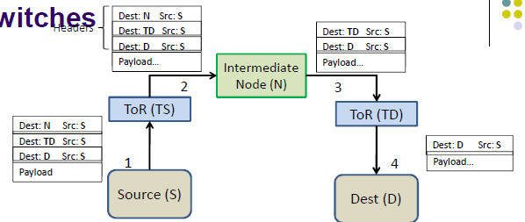
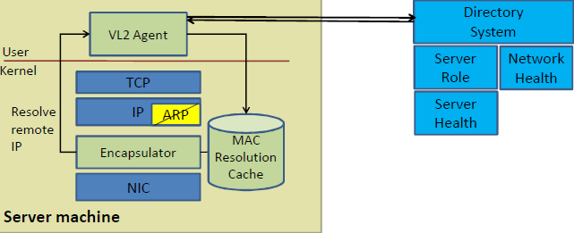
VL2
Use encapsulation to forward packet to ToR switch
Encapsulation used to transfer complexity to servers
Commodity switches have simple forwarding primitives
Complexity moved to computing the headers
Embracing end systems
Data center OSes already heavily modified for VMs, storage clouds, etc.
A thin shim for network support is no big deal
No change to applications or clients outside DC

Slide 19
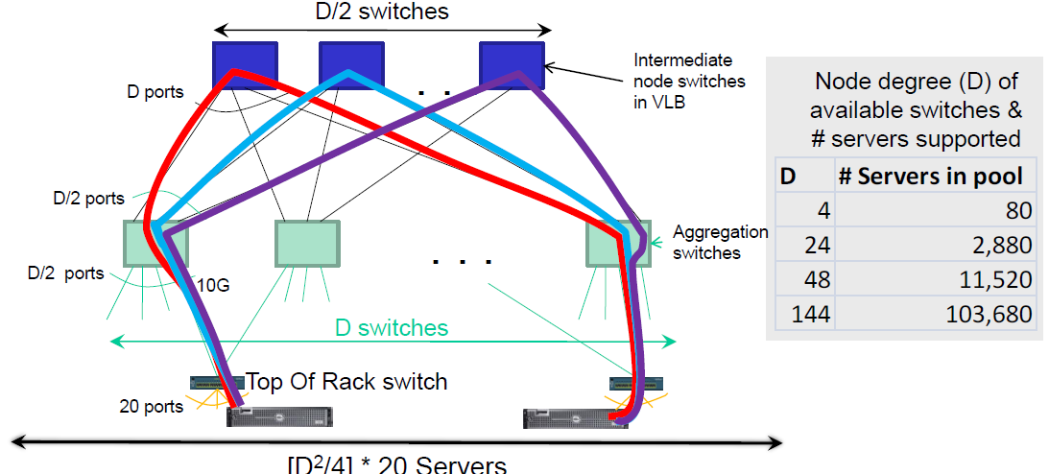
VL2
Use Randomization to Cope with Volatility
Valiant Load Balancing
Every flow “bounced” off a random intermediate switch
Traffic Forwarding: Random Indirection

Slide 20
Discussion:
Problem of VL2? VLB for large flows?
Agility?
Stale cache
Scalability of directory system
Performance according to each traffic types?
Comparison btw Portland & VL2?

Slide 21
Fastpass: A Centralized “Zero-Queue” Datacenter Network
Goals
Zero network queues
High Utilization
Multiple app and user objectives
Approach
Centralized arbiter schedules and assigns paths to all packets
Concerning
Latency: time slot allocation / path selection
Scaling: Too much burden at arbiter?
Fault tolerance: Single point of Failure?

Slide 22
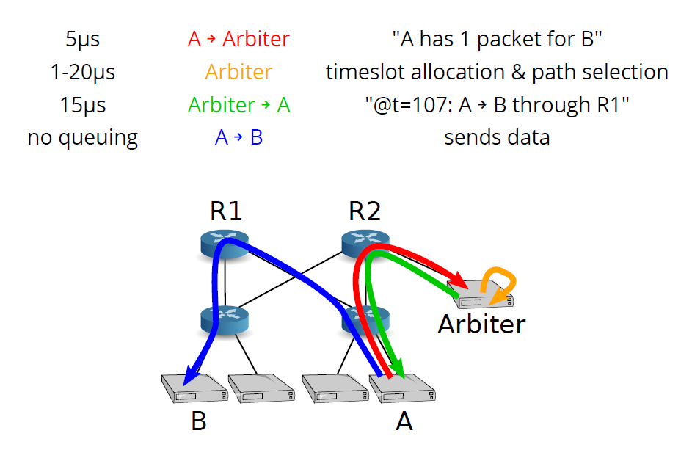
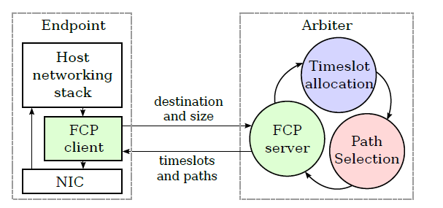
Fastpass: A Centralized “Zero-Queue” Datacenter Network
Example: Packet from A to B
Figure from the author’s presentation slides at SIGCOMM ‘14

Slide 23
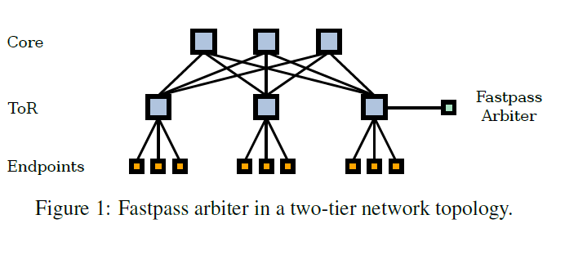
Fastpass: Architecture
Fastpass Architecture
Timeslot allocation:
Assign the requester a set of timeslots in which to transmit this data. The granularity of a timeslot is the time taken to transmit a single MTU-sized packet over the fastest link connecting an endpoint to the network. : 1.2 μs
2. Path selection:
The arbiter also chooses a path through the network for each packet and communicates

Slide 24
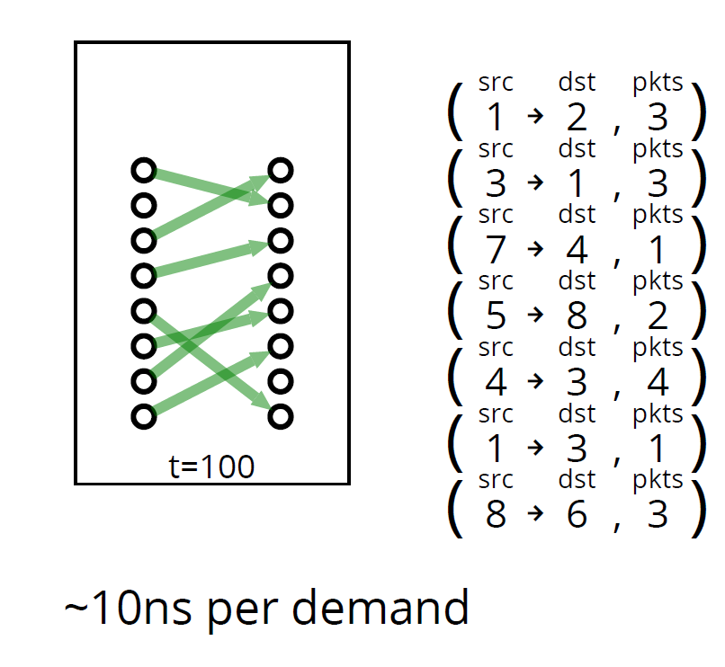
Fastpass: Timeslot allocation
maximal matching
Figure from the author’s presentation slides at SIGCOMM ‘14

Slide 25
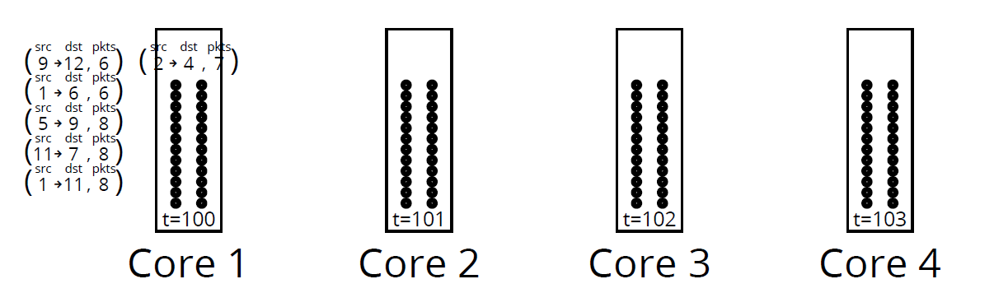
Fastpass: Timeslot allocation
Pipeline timeslot allocation
2211.8 Gbits/s on 8 cores
Figure from the author’s presentation slides at SIGCOMM ‘14

Slide 26
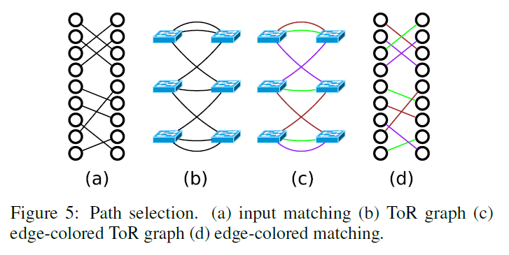
Fastpass: Path selection
Edge-coloring2211.8 Gbits/s on 8 cores

Slide 27
Fastpass: Arbiter failure
Multicore Arbiter
one primary and a few secondaries

Slide 28
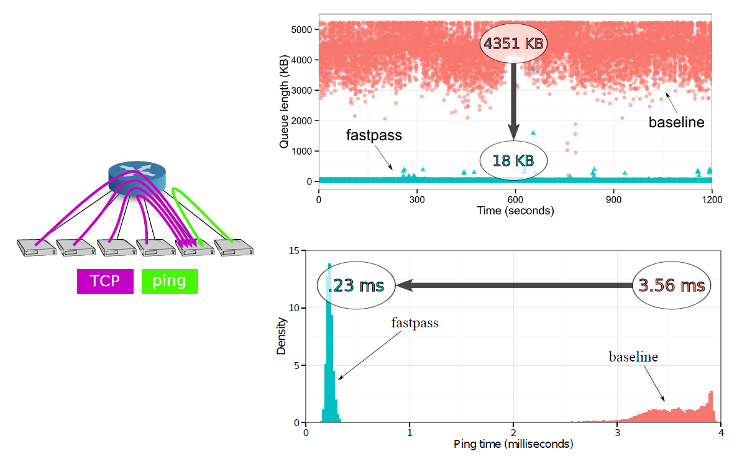
Fastpass: Facebook experiments:
Queues & RTT
Figure from the author’s presentation slides at SIGCOMM ‘14

Slide 29
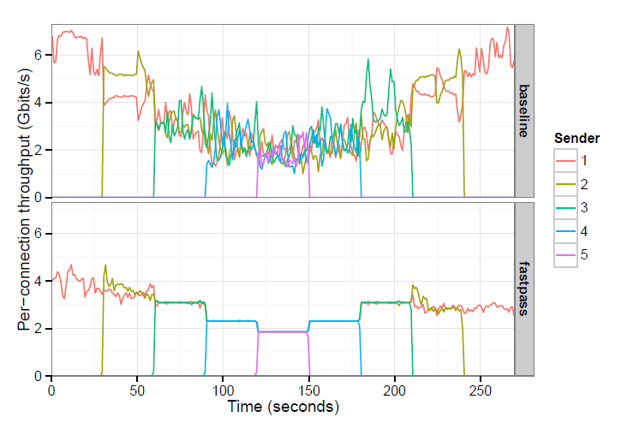
Fastpass: Facebook experiments:
Convergence to network share
max-min fair timeslot allocator
The lower one- and two-sender Fastpass throughput is due to Fastpass qdisc overheads
5200x
stddev

Slide 30
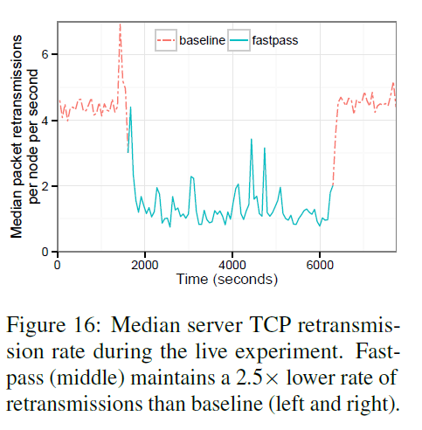
Fastpass: Facebook experiments:
Reducing retransmissions in production

Slide 31
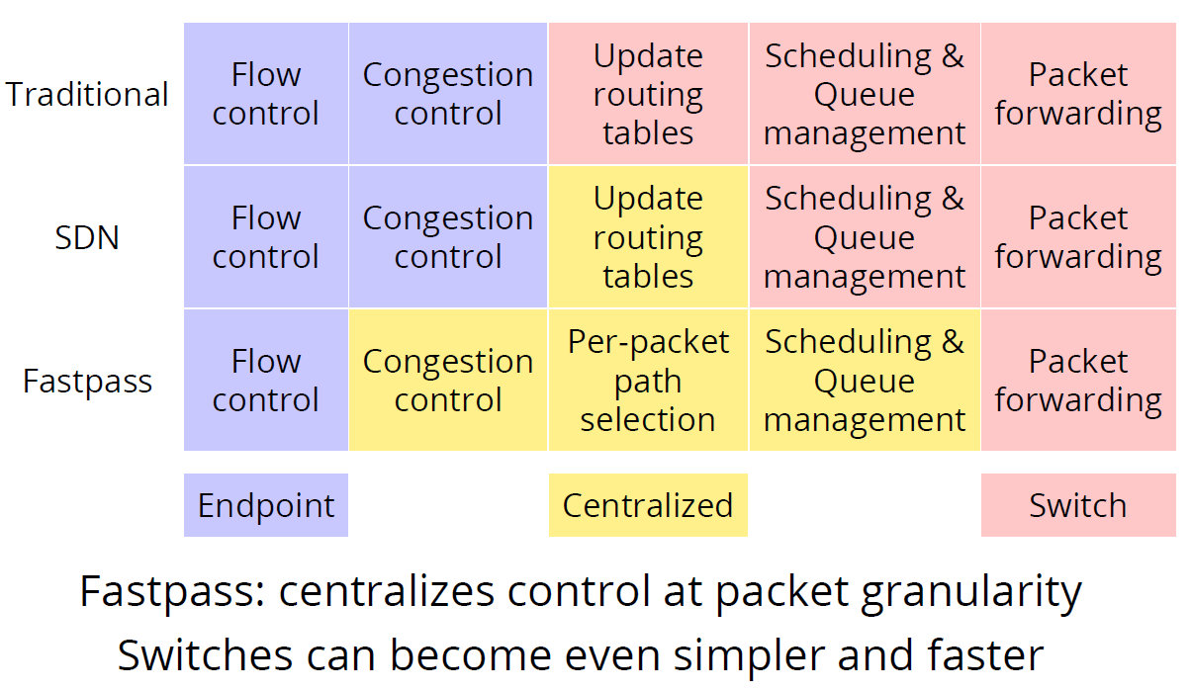
Fastpass enables new network designs
Figure from the author’s presentation slides at SIGCOMM ‘14

Slide 32
Discussion:
Is it ok for delay sensitive applications such as multimedia udp traffic?
Is it really zero queue?
Doubtful on fault tolerance of central arbiter. # of backup arbiters?
Heavy communication overhead with arbiter. TCP like?
Scalability of arbiter? Hierarchical architecture?
What will be the drawbacks of centralized control? ( discuss with the figure of previous slide)
Comparison with SDN or traditional approaches

Slide 33
ProjecToR: Agile Reconfigurable Data Center Interconnect
Need for a reconfigurable interconnect
Observation
Many rack pairs exchange little traffic
Only some hot rack pairs are active
Implication
Static topology with uniform capacity
Over-provisioned for most rack pairs
Under-provisioned for few others
➔ Need to dynamically provide additional capacity between hot rack pairs

Slide 34
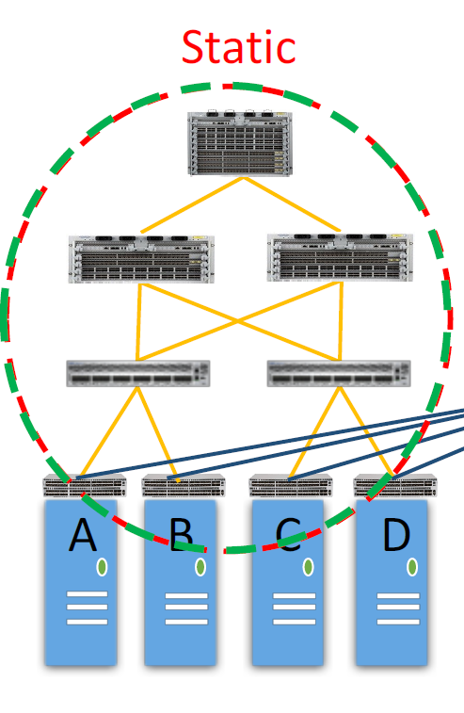
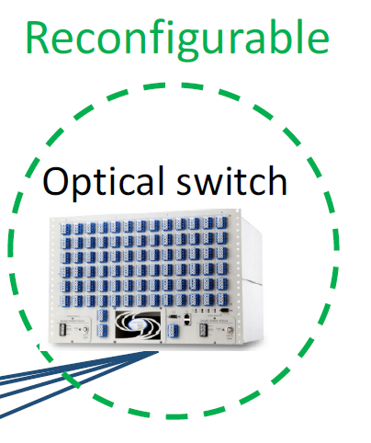
ProjecToR: Agile Reconfigurable Data Center Interconnect
Figure from the author’s presentation slides at SIGCOMM ‘16
Difficult to determine static vs. reconfigurable divide

Slide 35
ProjecToR: Agile Reconfigurable Data Center Interconnect
The traffic routing challenge
Dedicated links:
carry small flows possibly over multiple hops
change configuration at coarse time scales (e.g., daily)
Opportunistic links:
carry large flows over single hops
change rapidly based on current demand
➔ being based on the same technology,
how resources are split across ToRs and across time.

Slide 36
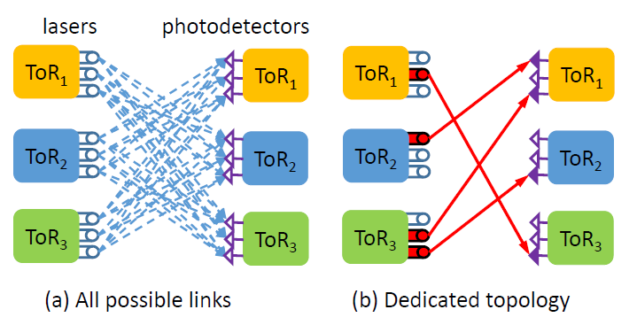
ProjecToR: Agile Reconfigurable Data Center Interconnect
Splitting lasers and photodetectors into dedicated and opportunistic between three ToRs.
Slow switching topology or dedicated topology
Fast switching links or opportunistic links
Given a set of potential links and current traffic demand, find a set of
active opportunistic links
➔ Blossom matching

Slide 37
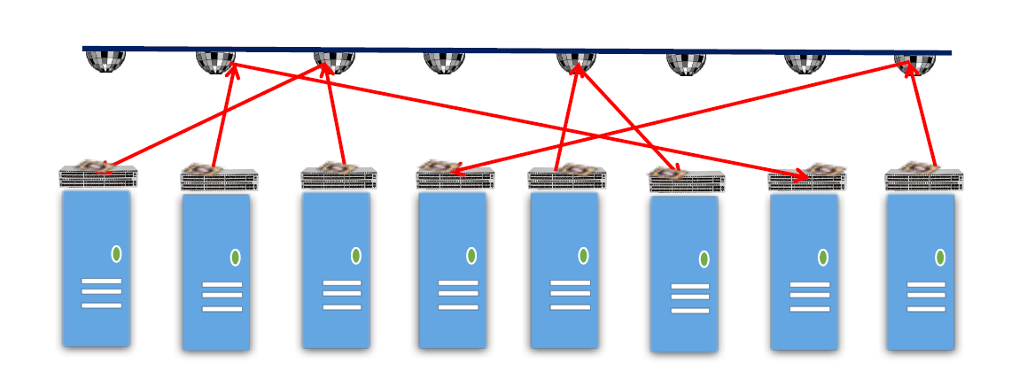
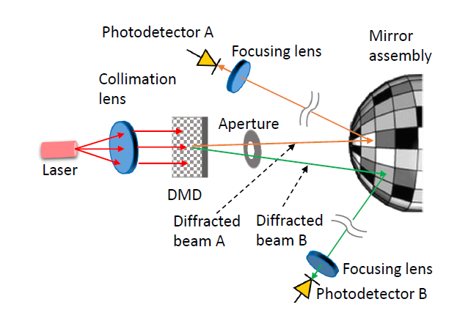
ProjecToR: Agile Reconfigurable Data Center Interconnect
Reconfiguration in a ProjecToR interconnect

Slide 38
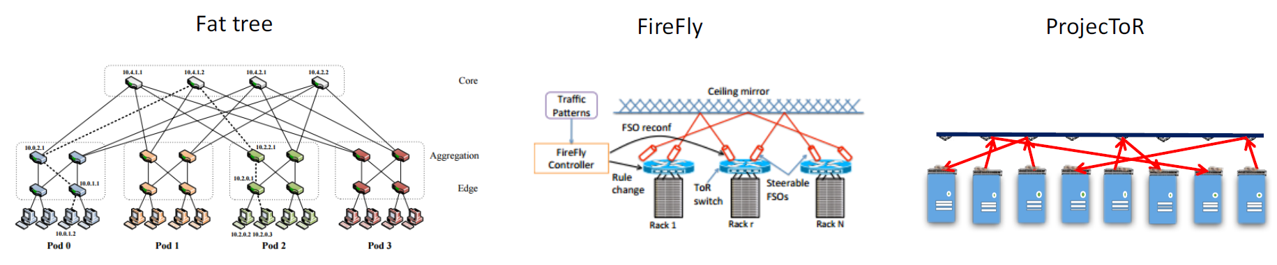
ProjecToR: Simulations
Figure from the author’s presentation slides at SIGCOMM ‘16
compared to the conventional folded-Clos interconnect,
ProjecToR can improve mean flow completion
time by 30–95% and reduce cost by 25–40%.

Slide 39
Comparison
Switch-centric structures:
cannot directly use existing Ethernet switches
do not support various traffic patterns well (e.g., one-to-all, all-to-all)
Higher performance with less server burden
Server-centric
require commodity switches
Well support all-to-all traffic patterns
Server burdens for relaying.
Hybrid Structure
Better than pure electrical ones in terms of complexity and power consumption,
optical devices are expensive
have not been widely used in data communications yet

Slide 40
Traffic Engineering
Open questions
Chance to have well structured topology; compared with the Internet
More symmetric, more redundant path…
Location of the services(or VMs) can be changed for better performance: traditional TE assumes locations of them are fixed
Can exploit centralized TE
collect all the link status and control the settings of all network components.
the scalability on the central controller could be the concern.
Design principles
Reliability
Load balancing
Energy-efficiency

Slide 41
Multicast Routing
Motivations
Many applications require group communications
Redirecting search queries to multiple indexing servers.
Distributing executable binaries to a group of servers participating Map-Reduce alike cooperative computations
Replicating file chunks in distributed file system
Existing Solutions
PIM: most widely used
PIM-SM or PIM-SSM : rendezvous point
Explicit Multi-Unicast (XCAST)
provides reception addresses of all destinations with each packet.
assumes that the stations participating in the communication are known ahead of time
distribution trees can be generated and resources allocated by network elements in advance of actual data traffic

Slide 42
Multicast Routing
Opportunities and challenges
Opportunities
Routing within DCN Nodes is with fewer hops and well structured topology
Challenges
Layer 2/3 switches with much higher link density
Nodes are not strong/reliable
usually a much larger set of multicasting groups
packet repair (e.g., with retransmission) in multicasting incur much higher overhead <= ack implosion or explosion, retransmission to selected nodes..
Design Guidelines
“in-switch bloom filters” or “in-packet bloom filters” or the combination
As a multicast group membership query mechanism on the switches/routers
Switches determine how to forward/replicate=>no need of big multicast routing table
Packet repair
The p2p packet fix/retransmission mechanism
To releases the source node from handling numerous retransmission

Slide 43
Routing Security
Motivations
Protecting topology discovery
Learn genuine topology to perform path selection
Data plane security
Short flow life and high routing agility
Existing Solutions
Control plane topology discovery tightly coupled with well-defined physical topologies.
For data-plane security, most existing mechanisms require a long flow duration over the same path <= DCN short flow life
Recent secure and relatively light-weight protocols leverage low-rate packet sampling or approximate flow finger- printing to prevent packet modification attacks.
Still it requires long detection delays

Slide 44
Routing Security
Challenges
Fundamental trade-off between flexibility and security
Existing secure data-plane protocols require a source node to know the exact path being used for monitoring and detection
Require paths to be stable over a long period, which is an unrealistic assumption for DCNs.
Design guidelines
should be tailored for the new (and somewhat simplified) attacker model, especially for the control plane.
should be stateless at the core switches to reduce the protocol overhead irrespective of the number of active flows,
should be path-oblivious
should not require the source node to know exact path due to the existence of dynamic multipath load balancing.

Slide 45
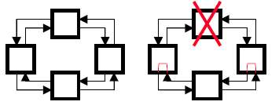
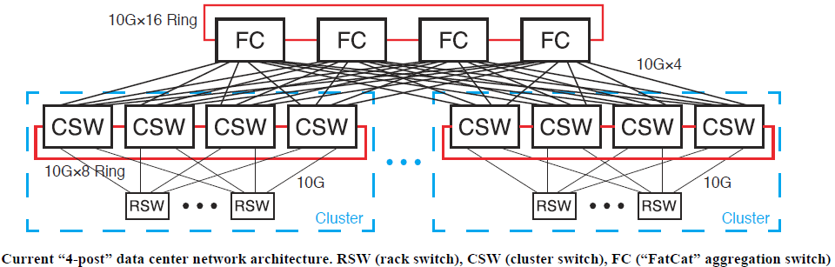
Facebook’s DCN Architecture
Each rack contains a rack switch(RSW) with up to 44 10G downlinks and 4 or 8 10G uplinks, one to each cluster switch(CSW)
Each CSW has four 40G uplinks (10G×4), one to each of four “FatCat” aggregation switches. The four CSWs in each cluster are connected in an 80G protection ring (10G×8)
The four FC switches are connected in a 160G protection ring (10G×16).

Slide 46
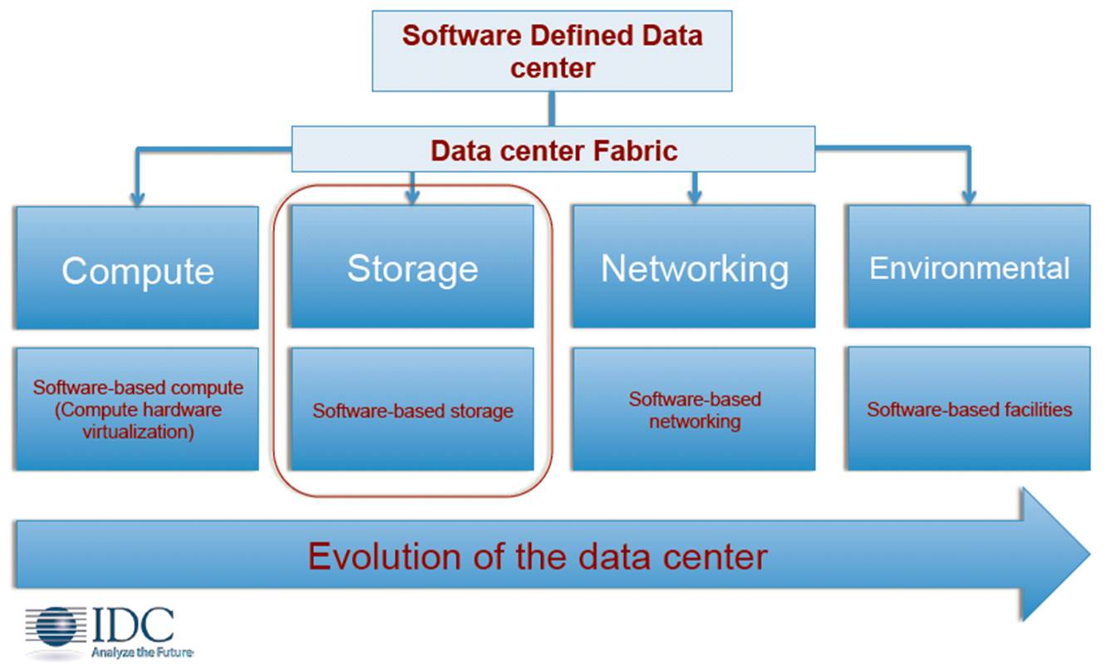
Software Defined Data Center
Virtual Data Center: VMware vCloud Suite
All infrastructure is virtualized and delivered as a service.
Network virtualization, server virtualization, storage virtualization,…

Slide 47
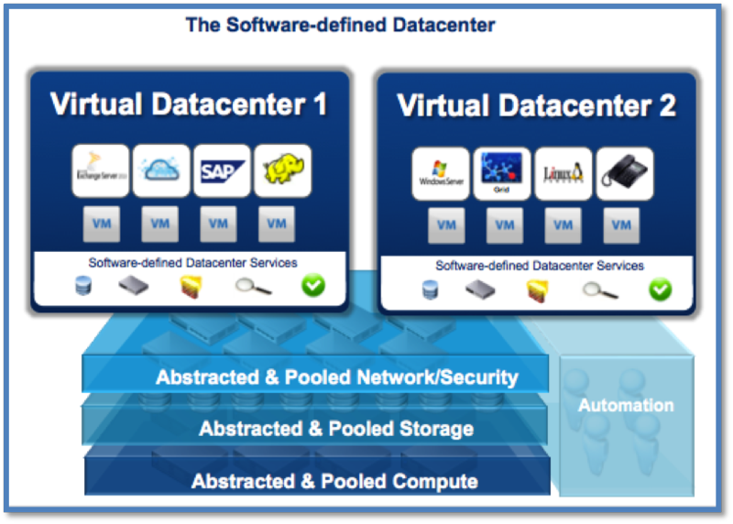
Software Defined Data Center
Software Defined Networking
On-demand, programmatic creation of tens of thousands of isolated virtual networks with the simplicity and operational ease of creating and managing virtual machines.

Slide 48
References
Kai Chen et al., “Survey on Routing in Data Centers: Insights and Future Directions”, IEEE Networks, July/August 2011

Slide 49
Discussion:
Vulnerable to vibration? Dust? Crosstalk? …. What can be the coutermeasure?
Other cost?
Can we find one DCN solution that can fit for most of all case?
Can we believe simulation results? Any other unexpected problems?
Redundant secondary path with fiber cable?
Is “Reconfigurable Data Center Interconnect” so definitely needed for DCN?

Slide 50
Feedbacks
Preparing more questions about the paper
Simpler presentation, more discussion
Too many reading assignment
Making discussion board at klms
More review session on the introduction of computer network that is dealt at undergraduate course
Too many slides! Need more discussion
Team based discussion?
More on Emerging technologies, Localization in networks, wireless networks, MIMO, interference,
Pick the most interesting essays not randomly
….

Slide 51
Reading Assignment
Mohammad Alizadeh et al., “Data Center TCP (DCTCP)”
Bryce Cronkite-Ratcliff et al., “Virtualized Congestion Control”
Keqiang He et al., “Virtual Congestion Control Enforcement for Datacenter Networks”
Submit less than 1 page report online via KLMS by 6pm Nov. 7th which is the day before the lecture of Nov. 8th (Tue.)
Submit also hard copy report at the beginning of the lecture of Nov. 8th (Tue.) as attendance check and for discussion

